Slide 1
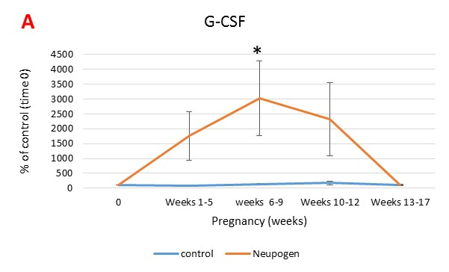
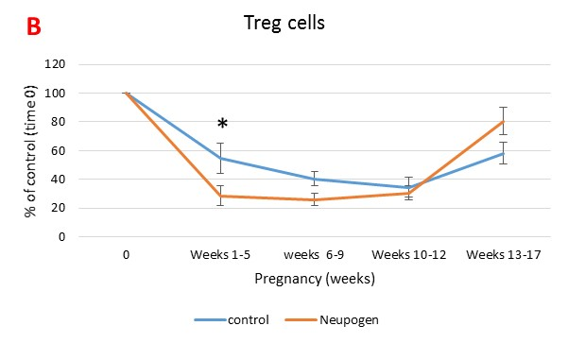
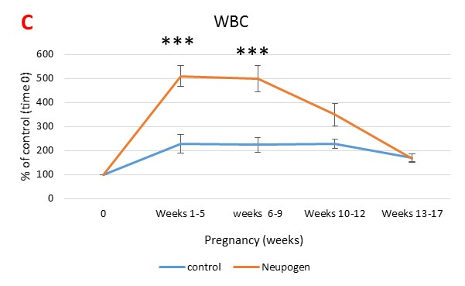
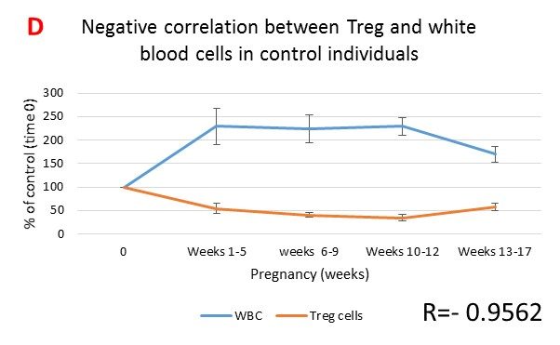
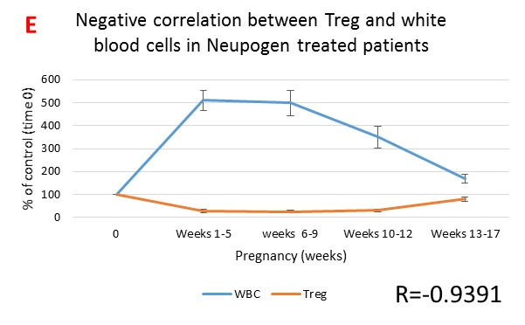
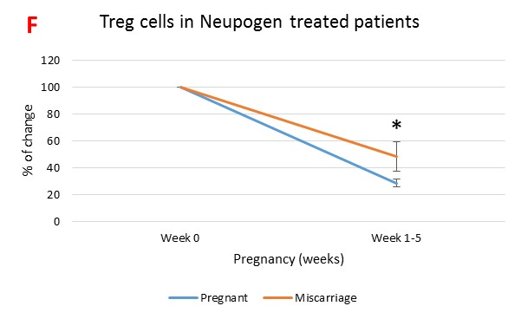
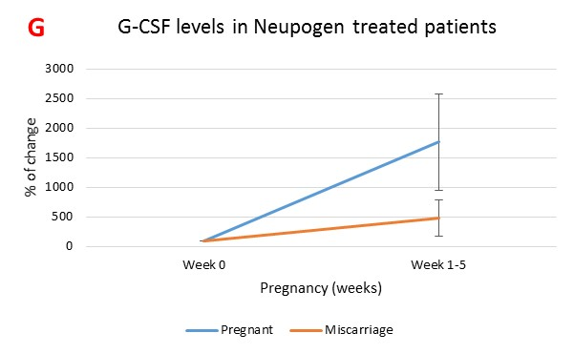
G-CSF enhances recruitment of regulatory T cells to the decidua during the first trimester in women with a history of recurrent miscarriage
Darren R. Ritsick¹, Nadera Mansouri-Attia¹, Cassidy Bommer¹, Benjamin Leader², Jeffrey Braverman¹
¹Braverman IVF and Reproductive Immunology, PC, NY, USA; ²ReproSource, Inc., MA, USA
Introduction
Method of Study
A critical role for antigen-specific regulatory T (Treg) cells in regulating tolerance to the semi-allogenic fetus in mammals is well established. A greater understanding of the dynamics of Treg cells during human pregnancy may provide an opportunity for monitoring of immunological function and effects of immunomodulatory agents in pregnant patients. Published studies disagree however regarding whether Treg cells increase or decrease in peripheral blood of pregnant human subjects, and effects of immunomodulatory agents on Treg cells in pregnancy are largely unknown.
Women with a history of idiopathic recurrent miscarriage were treated with G-CSF (Neupogen; “Neupogen”) or other treatment (Intralipid and/or prednisone; “control”). Treatment was initiated at ovulation and discontinued at week 12 of pregnancy. Blood was drawn and levels of total white blood cells (WBCs), Treg cells, and G-CSF were assessed at various time points (T₀=pre-pregnancy; T₁=4-5 weeks; T₂=6-9 weeks; T₃=10-12 weeks; T₄=13-17 weeks). Treg cells were identified as CD3⁺CD4⁺CD25^{hi}CD127^{lo}FoxP3⁺.
Results
a
c
b
b
a
b
b,c
b
b
b,c
a
a
b
b
b
(A) Neupogen injections significantly increased serum levels of G-CSF. (B) Relative to T₀ levels, Treg cells decreased by 45% at T₁, 60% at T₂, and 65% at T₃ before rebounding back to 41% by T₄ in the control group. G-CSF significantly enhanced the decrease in Treg cell levels at T₁ and T₂, with Treg cells decreasing by 72% and 74% at these time points. (C) Levels of WBCs increased in the control group at T₁-T₄, which was amplified by G-CSF, and (D-E) levels of WBCs and Treg cells were strongly inversely correlated at all time points in both groups (R=-0.956 in Neupogen group and R=-0.939 in control group). (F-G) Serum levels of G-CSF were lower and the decrease in Treg cells was significantly reduced in Neupogen patients experiencing implantation failure with IVF or a chemical pregnancy.
Conclusions
References
Our data agree with more recent studies showing a decrease in peripheral blood Treg cell levels during the first trimester due to recruitment to the decidua, and further show an enhancement of this migration by G-CSF, suggesting a mechanism by which G-CSF promotes fetal tolerance and increases live birth rate in women with a history of recurrent miscarriage. The strong inverse correlation with total WBCs likely reflects involvement of a subpopulation of tolerogenic WBCs, such as myeloid-derived suppressor cells (MDSCs), involved in regulation of Treg cell expansion and migration.
Ziegler, A., et al., Self Nonself, 2010. 1(3): p. 176-191.
Setchell, J.M., et al., Am J Primatol, 2013. 75(10): p. 1021-31
Beydoun, H. and A.F. Saftlas, Tissue Antigens, 2005. 65(2): p. 123-35.
Takakuwa, K., et al., Clin Immunol, 2006. 118(1): p. 101-7.

