Slide 1
Intralipid® Therapy for Recurrent Pregnancy Loss – Controversies and Future Directions
34th Annual Meeting of the American Society for Reproductive Immunology
June 2-5, 2014
Jeffrey Braverman, MD, FACOG
Notes:
I have made a career out or reading all of the great work that has been published by the scientists in this society over the last 25 years and making my best attempts to apply it clincially.
Truly the only audience where I can feel proud “and safe” saying that I am a Reproductive Immunologist. At least here no one will say I don’t believe in T reg Cells or the Immune system plays no part in pregnancy loss , it can sometimes get quite lonely out there!!

Slide 2
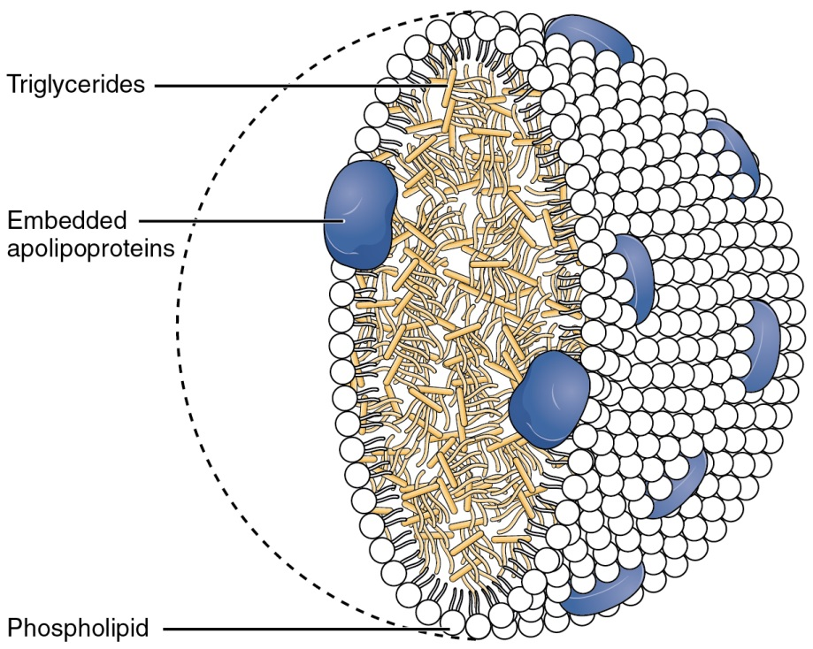
Intralipid® - What is it?
Fat emulsion containing soybean oil, glycerin and egg phospholipids
Egg phospholipids act as an emulsifier
Common component of parenteral nutrition in patients unable to tolerate an oral diet
Soybean oil lipid emulsion provided at triacylglycerol concentrations of 10%, 20%, or 30% (wt:vol)
100-500 nm droplets that simulate chylomicrons
Lipoproteins with triacylglycerol core and outer monolayer of phospholipids that transport dietary fatty acids in blood

Slide 3
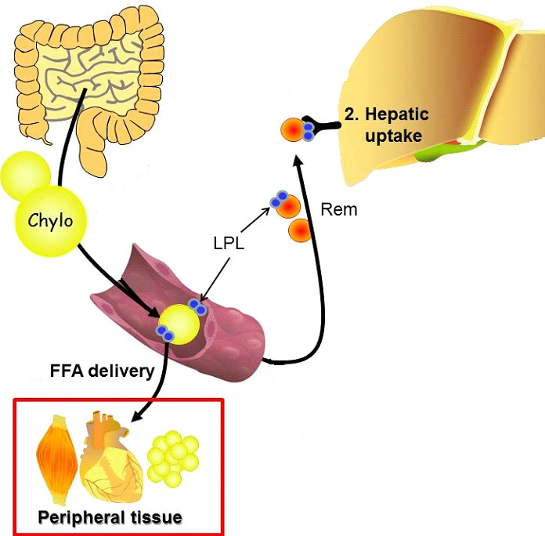
Intralipid Metabolism
Degradation takes place at extrahepatic endothelial sites
Lipoprotein lipase-mediated hydrolysis results in fatty acid (FA) release from triacylglycerides and reduction in size of emulsion remnant particles
Remnant particles taken up by liver resulting in intracellular delivery of FAs not released by lipoprotein lipase-mediated hydrolysis

Slide 4
Fatty Acid Nomenclature
Defined by length - 2-30 carbons in length
Short chain (SCFAs) = up to 4 carbons
Medium chain (MCFAs) = 6-12 carbons
Long chain (LCFAs) = ≥ 14 carbons
Defined by saturation (presence of double bonds) - saturated, monounsaturated (MUFAs) and polyunsaturated (PUFAs)
Monounsaturated = 1 double bond
Polyunsaturated = 2 or more double bonds
Defined by position of double bond (for unsaturated FAs) - omega-3 (ω-3), omega-6 (ω-6), omega-9 (ω-9)
Refers to the position of the first double bond
Defined by availability through diet
Essential
Can only be obtained through diet
Non-essential
Can be produced from other FAs

Slide 5
Fatty Acid Composition of Intralipid
FAs in Intralipid® include linoleic (44-62%), α-linolenic (4-11%), oleic (19-30%), palmitic (7-14%) and stearic (1.4-5.5%) acid
Linoleic acid is an ω-6 FA that is:
Essential
Long chain (18 carbon)
Polyunsaturated
α-linolenic acid is an ω-3 FA that is:
Essential
Long chain (18 carbon)
Polyunsaturated
Oleic acid is an ω-9 FA that is:
Nonessential
Long chain (18 carbon)
Palmitic acid is a FA that is:
Nonessential
Long chain (16 carbon)
Stearic acid is a FA that is:
Nonessential
Long chain (18 carbon)
Saturated
Notes:
Note about long chain is that they must be taken IC to be metabolized, unlike SC or MC Fas.

Slide 6
History of Intralipid
Initial use of fat emulsions for parenteral nutrition in the 1930s
Initial preparations were composed of olive oil and milk
Linkage of malnutrition and post-operative mortality led to development of better fat emulsions with less risk
Intralipid developed in 1961
Drug delivery of fat soluble drugs
Propofol
Etomidate
Treatment for overdose of fat soluble drugs
Verapamil toxicity

Slide 7
Early Evidence for Immunosuppressive Effects of Intralipid Infusion
Clinical observations in the 1980s and early 1990s showed increased risk of bacteremia in neonatal patients using lipid-based parenteral nutrition (Jarvis, 1983; Freeman, 1990; Goldmann, 1990)
IV lipids increased infection rates in surgical patients
Increased risk of infective complications noted in mildly malnourished surgical patients (Snydman, 1982)
Lower rates of graft versus host disease after bone marrow transplantation in patients using soybean oil-based parenteral nutrition (Muscaritoli, 1998)
Trial in 1991 to determine efficacy of trophoblast membrane vesicles for treating recurrent pregnancy loss found a greater success rate in women receiving the control which was Intralipid (Johnson, 1991)
Study in 1994 showed a significant Intralipid effect in preventing abortion in the abortogenic DBA/2JxCBA/J mouse model (Clark, 1994)

Slide 8
NK Cells in Reproductive Immunology
Evidence that NK cell cytotoxic activity mediates recurrent pregnancy loss
Several studies show that peripheral NK cell cytotoxicity and NK cell numbers are increased in women with infertility, repeat implantation failure, recurrent pregnancy loss, and preeclampsia (Agarwal, 2006; Coulam, 2003; Fukui, 2008; King, 2010; Ntrivalas, 2001; Shakhar, 2003; Fukui, 2012; Sacks, 2012; Thum, 2004)
Some studies show increased release of granulysin from uterine NK cells in samples from spontaneous abortion

Slide 9
A Role for NK Cell Inhibition in the Immunosuppressive Mechanism of Intralipid?
Report in 2007 by Dr. Coulam’s group showed an ability of Intralipid to reduce NK cell cytotoxicity
in vitro at 18 and 9 mg/ml (Roussev, 2007)
Showed equal suppressive effect as IVIG and sHLA-G
Report in 2008 by Dr. Coulam’s group showed in vivo suppression of NK cell cytotoxicity (Roussev, 2008)
Infusion of 2-4 mls of 20% Intralipid (in vivo concentration was not directly measured)
Report in 2012 by Dr. Coulam’s group showed, in women with elevated NKa, equal effect of Intralipid and IVIG on live birth rate (Coulam, 2012)
Patients with “normal” NKa excluded
Patients positive for APAs excluded

Slide 10
Assessment of Uterine NK Cells
Studies showing relationship between elevated uNK numbers and or activity with failed implantation or pregnancy related complications
Dr. Ledee’s group (also looked at effects on sub-endometrial angiogenesis)
Ledee-Bataille, 2005; Ledee, 2008; Ledee, 2011
Lachapelle, 1996; Quenby, 2005; Giuliani, 2014; Russell, 2013
Treatment with Intralipid
Assumption was made that uNK cells will be suppressed by Intralipid similar to demonstrated effect on peripheral NK cells
Notes:
Are uNK cells pbNK cells that migrate to endometrium in certain pathological conditions and therefore likely to be suppressed by IL therapy?
Sacks?
Do uNK cells arise from endometrial progenitor cells (and not from pbNK cells) and therefore lacking direct evidence for suppression by IL? (reference)
Are uNK cells pbNK cells that are reprogrammed in the endometrium and therefore lacking direct evidence for suppression by IL? (reference)

Slide 11
Immunomodulatory Effects of Intralipid
Free fatty acids mechanism of action
Mechanisms appear related to mostly ω-6 (linoleic acid) and ω-3 (α-linolenic acid)
Many metabolites many avenues for modulation
PGE2 (linoleic acid metabolite)
Inhibitor of NK activity
PGE2 also stimulates inflammatory pathways
Metabalomic studies show even more possible modulatory effects
Immunometabolism another pathway for immunomodulation (may explain modulation of T cell activity)
Angiogenic properties of Intralipid (a new frontier of treatment?)
How concentration significantly modifies Intralipid immunommodulation
Adverse effects of Intralipid and drug interactions
In vitro laboratory analysis of Intralipid efficacy

Slide 12
Regulation of Cellular Function by FAs
FAs incorporate into phospholipids in plasma membranes and alter membrane fluidity and organization of lipid rafts
Function as direct ligands for nuclear receptors
Peroxisome proliferator-activated receptors (PPARs)
Regulate gene expression
Function as ligands for G-protein-coupled receptors (GPCRs)
GPR40, GPR43, etc
Affects intracellular signaling pathways
Effects function of phospholipid-derived second messengers
PIP₂, DAG, etc affecting signaling pathways
Enzymatic conversion to bioactive lipid mediators (eicosanoids)

Slide 13
Immunomodulatory Effects of Intralipid
Free fatty acids mechanism of action
Mechanisms appear related to mostly ω-6 (linoleic acid) and ω-3 (α-linolenic acid)
Many metabolites many avenues for modulation
PGE2 (linoleic acid metabolite)
Inhibitor of NK activity
PGE2 also stimulates inflammatory pathways
Metabalomic studies show even more possible modulatory effects
Immunometabolism another pathway for immunomodulation (may explain modulation of T cell activity)
Angiogenic properties of Intralipid (a new frontier of treatment?)
How concentration significantly modifies Intralipid immunommodulation
Adverse effects of Intralipid and drug interactions
In vitro laboratory analysis of Intralipid efficacy

Slide 14
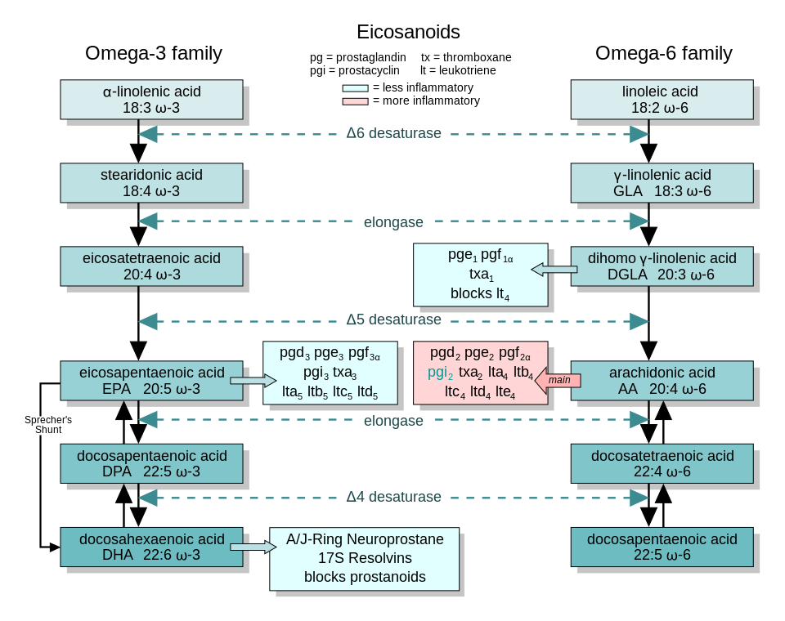
Notes:
Linoleic acid 2.5% breakdown compared to 18% for alpha linoliec acid. Vitamin and mineral production can affect breakdown of gamma linoliec. Displacement of AA by EPA in cell membrane also decreases the amount of inflammatory modulators. Overall omega 3 lower inflammatory cytokines and omega 6 mostly cellularu NK or T cell.
How did IL exert their immunosupprresive effect , was it just on NK cells or other parts of the immune system. To answer this we have to understand the metabolic breakdown of the key components in IL.

Slide 15
Immunomodulatory Effects of Intralipid
Free fatty acids mechanism of action
Mechanisms appear related to mostly ω-6 (linoleic acid) and ω-3 (α-linolenic acid)
Many metabolites many avenues for modulation
PGE2 (linoleic acid metabolite)
Inhibitor of NK activity
PGE2 also stimulates inflammatory pathways
Metabalomic studies show even more possible modulatory effects
Immunometabolism another pathway for immunomodulation (may explain modulation of T cell activity)
Angiogenic properties of Intralipid (a new frontier of treatment?)
How concentration significantly modifies Intralipid immunommodulation
Adverse effects of Intralipid and drug interactions
In vitro laboratory analysis of Intralipid efficacy

Slide 16
PGE2 Inhibits NK Cell Activity
There are negative correlations between the levels of ω-6 PUFAs in serum and basal NK cell activity (Rasmussen, 1994)
Prostaglandin E2 (PGE2) is generated from AA through ω-6 PUFA metabolism
PGE2 can suppress NK cell cytotoxicity (Juman 2013)
Downregulation of activating receptors NKG2D and 2B4
Inhibition of IL-15 induced IFNγ production
PGE2 can inhibit crosstalk between uterine NK cells and uterine dendritic cells (DCs) that are intimately associated in the endometrium(Bos, 2011)
Other studies showing regulation of NK cells by ω-3 PUFAs
May occur through activation of PPARγ
Notes:
Studies show that different immunologic states dictate the number and funciton of PGE2 and other receptors that may interact with FAs leading to different effects of IL on different patients. In fact the suppresson of NK cell activity by PGE2 leads to tumor gowth (secreted by tumors).

Slide 17
Inflammatory Effects of PGE2

Slide 18
Immunomodulatory Effects of Intralipid
Free fatty acids mechanism of action
Mechanisms appear related to mostly ω-6 (linoleic acid) and ω-3 (α-linolenic acid)
Many metabolites many avenues for modulation
PGE2 (linoleic acid metabolite)
Inhibitor of NK activity
PGE2 also stimulates inflammatory pathways
Metabalomic studies show even more possible modulatory effects
Immunometabolism another pathway for immunomodulation (may explain modulation of T cell activity)
Angiogenic properties of Intralipid (a new frontier of treatment?)
How concentration significantly modifies Intralipid immunommodulation
Adverse effects of Intralipid and drug interactions
In vitro laboratory analysis of Intralipid efficacy

Slide 19
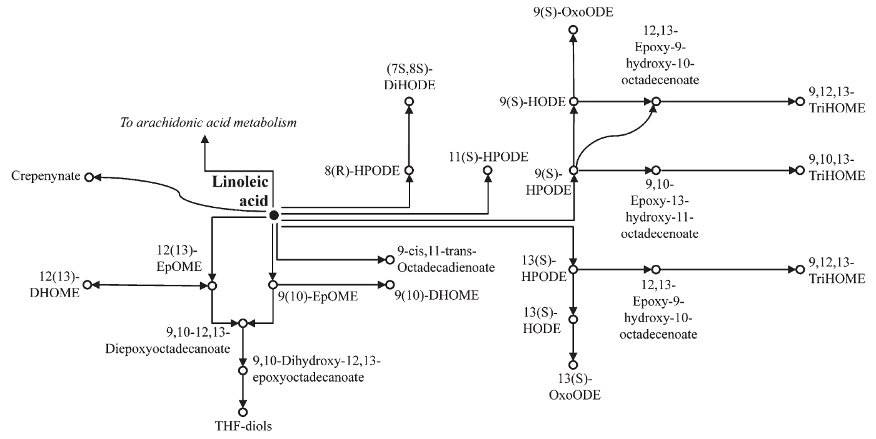
Linoleic Acid Peroxide Metabolites May Play a Role in Immunosuppressive Effects of Intralipid
Unsaturated FAs can also undergo lipid oxidation to produce lipid peroxides and epoxides and their diols
Recent study of metabolome following Intralipid infusion found elevated levels of 12(13)-DHOME (isoleukotoxin diol) (Edwards, 2012)
PPARγ ligand with wide-ranging effects including immunosuppression
Notes:
There are so many metabolites that are still yet to be studies that is it is very difficult to understand the mechanisms of immunosuppression or activation. 12,13 DHOME strong immunosuppresant and immediatley present after IL transfusion. PPAR gamma can interfere with NFKP

Slide 20
Immunomodulatory Effects of Intralipid
Free fatty acids mechanism of action
Mechanisms appear related to mostly ω-6 (linoleic acid) and ω-3 (α-linolenic acid)
Many metabolites many avenues for modulation
PGE2 (linoleic acid metabolite)
Inhibitor of NK activity
PGE2 also stimulates inflammatory pathways
Metabalomic studies show even more possible modulatory effects
Immunometabolism another pathway for immunomodulation (may explain modulation of T cell activity)
Angiogenic properties of Intralipid (a new frontier of treatment?)
How concentration significantly modifies Intralipid immunommodulation
Adverse effects of Intralipid and drug interactions
In vitro laboratory analysis of Intralipid efficacy

Slide 21
Beyond NK Cells - Other Immunological Targets of Intralipid
Other immunological abnormalities are present in recurrent miscarriage patients
Reproductive autoimmune failure syndrome
“In analogy, to animal models, immunologic reproductive failure in humans, may therefore not be the consequence of specific autoantibody abnormalities or natural killer (NK)-cell abnormalities, but the reflection of a misdirection of a more broadly based immune response.” (Gleicher, 2002)
Notes:
Other actions of IL may be hidden in other immunological abnormalities in RPL patients , we feel he identified one of what we believe are many different autoimmune patterns that we feel are most likely related to udnerlying autoimmune disease as many match the laboratory findings in women with autoimmune syndromes. We have followed HLA patterns, wide variety of serum cytokines , IC ratios and of course all aantibody studies. So we have seen syndromes where Nka are normal and looked for other possible benefits of IL.

Slide 22
A Role for Immunometabolic Regulation of T Cells by Intralipid
T cells play an important role in the response to a semi-allogenic fetus
Importance of regulatory T cells (Treg cells) to maintaining pregnancy in mammals is widely accepted
Detailed understanding of immunometabolism at the cellular level is emerging
Particularly relating to T cell activation and function

Slide 23
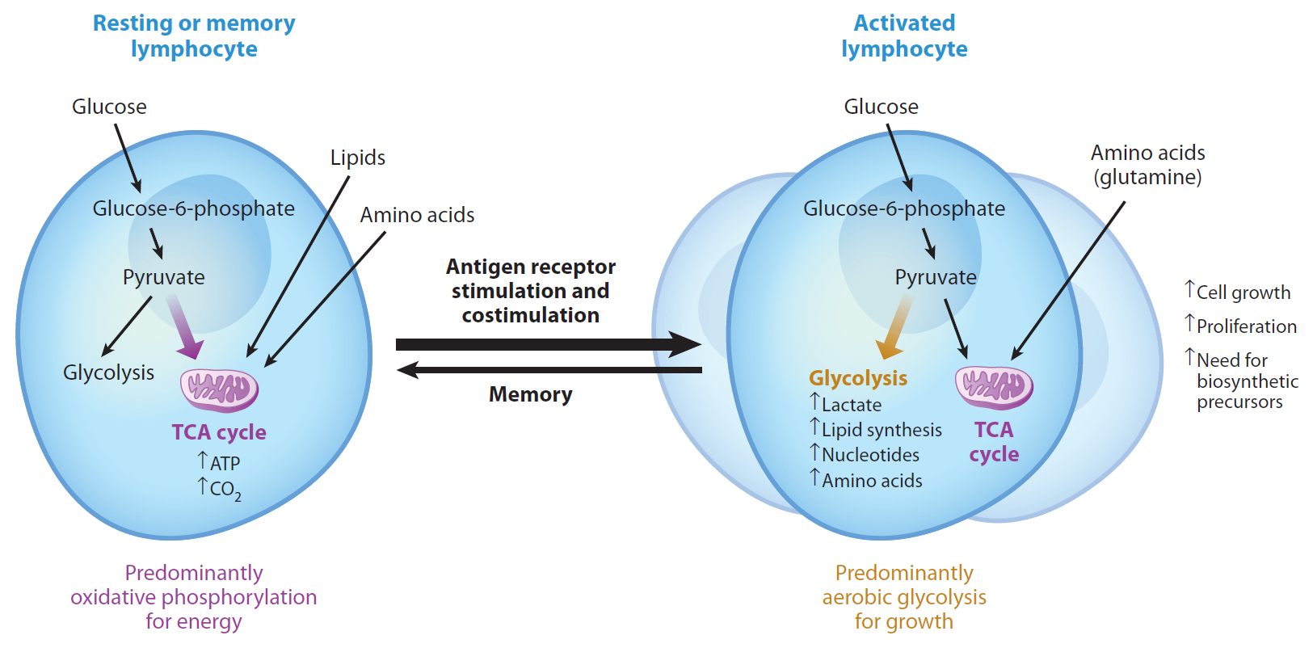
Metabolic Regulation of T Cell Activation
Resting T cells use a balanced “diet” of glucose and lipids for their metabolic fuel
Activation of effector T cells (Teff cells; CTL/Th1/Th2/Th17) causes them to shift metabolism toward glycolysis and away from lipid oxidation

Slide 24
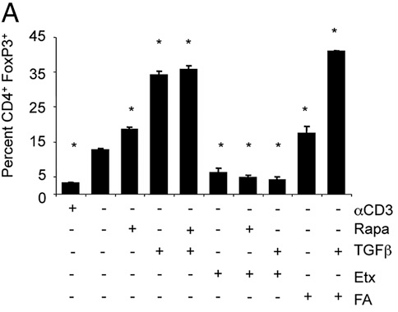
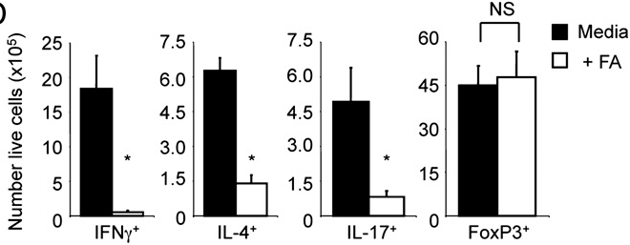
Fatty Acid Effects on Effector and Regulatory T Cells
Metabolic requirements of Treg cells recently investigated (Michalek, 2011)
Exogenous FAs promote Treg cell differentiation
May be due in part to regulation of cell survival as exogenous FAs caused a significant loss of viable Th1, Th2 and Th17 cells

Slide 25
Immunological Tolerance – Hold the Sugar, Pass the Fat?
Metabolic requirement differences between Teff cells and Treg cells can be exploited therapeutically through the use of FAs and metformin
Metformin favors Treg cell differentiation during T cell activation
Notes:
This is a summary slide for the previous section to tie it all in for the audience

Slide 26
Immunomodulatory Effects of Intralipid
Free fatty acids mechanism of action
Mechanisms appear related to mostly ω-6 (linoleic acid) and ω-3 (α-linolenic acid)
Many metabolites many avenues for modulation
PGE2 (linoleic acid metabolite)
Inhibitor of NK activity
PGE2 also stimulates inflammatory pathways
Metabalomic studies show even more possible modulatory effects
Immunometabolism another pathway for immunomodulation (may explain modulation of T cell activity)
Angiogenic properties of Intralipid (a new frontier of treatment?)
How concentration significantly modifies Intralipid immunommodulation
Adverse effects of Intralipid and drug interactions
In vitro laboratory analysis of Intralipid efficacy

Slide 27
Intralipid Effects on Vasculature
Failures of embryo implantation have been associated with abnormal angiogenesis/arteriogenesis
Dr. Moffett’s work on HLA-C/KIR interactions in regulating spiral artery remodeling
Dr. Ledee’s work showing abnormalities in uterine blood flow associated with altered uterine NK cell function
Abnormal vessel development leading to elevated uterine vascular resistance may be a target of Intralipid therapy
Intralipid effective at reversing pulmonary arterial hypertension in rats
Stimulation of angiogenesis, suppression of inflammation
Normalization of Doppler studies
Anecdotal evidence of normalization of abnormal umbilical Doppler studies in growth restricted pregnancies
Notes:
Omega 6 has been shown to elelvate VEGF and maybe one of the beneifts of IL when uNK is abnormal and not a direct effect on the NK as in pNK. In PAH pts received IL dialy so we need to study dosing and safety in this regard.

Slide 28
Immunomodulatory Effects of Intralipid
Free fatty acids mechanism of action
Mechanisms appear related to mostly ω-6 (linoleic acid) and ω-3 (α-linolenic acid)
Many metabolites many avenues for modulation
PGE2 (linoleic acid metabolite)
Inhibitor of NK activity
PGE2 also stimulates inflammatory pathways
Metabalomic studies show even more possible modulatory effects
Immunometabolism another pathway for immunomodulation (may explain modulation of T cell activity)
Angiogenic properties of Intralipid (a new frontier of treatment?)
How concentration significantly modifies Intralipid immunommodulation
Adverse effects of Intralipid and drug interactions
In vitro laboratory analysis of Intralipid efficacy

Slide 29
Concentration Dependent Immunosuppressive Effects of Intralipid
Evidence in the literature supports a strong association of soybean oil triglyceride concentration in the serum with immunosuppressive effects of Intralipid
Studies show 100cc Intralipid – 2.5-20mg/ml “in vivo” (Wanten, 2007)
NK cell cytotoxicity – low concentration in vitro (2.5 mg/ml) (Coulam, Loo)
Production of IgG, IgM, and IgA (2.5-20mg/ml) (Salo, 1997)
Decreased lymphocyte proliferation (2.5-10 mg/ml)
Antibody dependent cellular cytotoxicity (ADCC) (> 25 mg/ml)
Inhibition of chemotaxis (above 100 mg/ml) (Wiernek)
Concentration can be affected by
Rate of infusion
Preexisting triglyceride levels
Presence of LPL polymorphisms
Volume of Intralipid being transfused
Notes:
Studies show that 100cc gives concentration of 2.5-20 over time(so 2cc must be a much lower in vivo concentration). IGG suppressin at higher doses may be related to class switching. Important with HLA abs. ADCC important mechanism in many autoimmune diseases and we believe play a part in RPL.

Slide 30
Immunomodulatory Effects of Intralipid
Free fatty acids mechanism of action
Mechanisms appear related to mostly ω-6 (linoleic acid) and ω-3 (α-linolenic acid)
Many metabolites many avenues for modulation
PGE2 (linoleic acid metabolite)
Inhibitor of NK activity
PGE2 also stimulates inflammatory pathways
Metabalomic studies show even more possible modulatory effects
Immunometabolism another pathway for immunomodulation (may explain modulation of T cell activity)
Angiogenic properties of Intralipid (a new frontier of treatment?)
How concentration significantly modifies Intralipid immunommodulation
Adverse effects of Intralipid and drug interactions
In vitro laboratory analysis of Intralipid efficacy

Slide 31
Drug Interactions and Potential Adverse Effects of Intralipid
Potentiating infection
Fatty acids do cross placenta and are found in the baby
Allergy
Splenomegaly
Elevated liver enzymes
Thrombocytopenia
Lymphopenia
Fatty overload syndrome
Highest risk patients are those with:
Insulin resistance
Obesity
Diabetes
LPL polymorphisms
May effect efficacy of fat soluble drugs
Vitamin D3
Some evidence that heparin and low molecular weight heparin may interfere with some immunological effects of Intralipid
Notes:
Endotoxin challenge sepsis made worse with IL , infection should be considered when inflammatory response is seen in patients receiving IL LPL found to downregulate with high levels of FA

Slide 32
Immunomodulatory Effects of Intralipid
Free fatty acids mechanism of action
Mechanisms appear related to mostly ω-6 (linoleic acid) and ω-3 (α-linolenic acid)
Many metabolites many avenues for modulation
PGE2 (linoleic acid metabolite)
Inhibitor of NK activity
PGE2 also stimulates inflammatory pathways
Metabalomic studies show even more possible modulatory effects
Immunometabolism another pathway for immunomodulation (may explain modulation of T cell activity)
Angiogenic properties of Intralipid (a new frontier of treatment?)
How concentration significantly modifies Intralipid immunommodulation
Adverse effects of Intralipid and drug interactions
In vitro laboratory analysis of Intralipid efficacy

Slide 33
Is In Vitro Testing of Intralipid Effects Valid?
Intralipid does not get metabolized in vitro
Concentrations of 9 mg/ml and 18 mg/ml are higher than in vivo concentrations achieved by infusion of 2-4 mls
Does not take into account effects on NK cell activity that result from secondary mediators formed in vivo (ie, cytokines, lipid mediators like eicosanoids, etc)
Some anatomical locations may not achieve Intralipid concentrations predicted by calculations
Lymph nodes
Notes:
Lipoprotein lipase which frees the fatty acids from triglycerides is mainly found on the luminal surface of endothelial cells in capillaries
Even if some free FA is released there are no enzymes to convert linoleic and α-linolenic to arachadonic acid, EPA, DHA, and other bioactive lipid mediators that are responsible for many of the effects of Intralipid

Slide 34
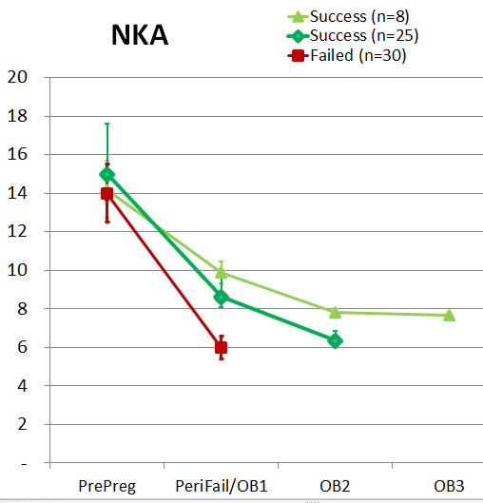
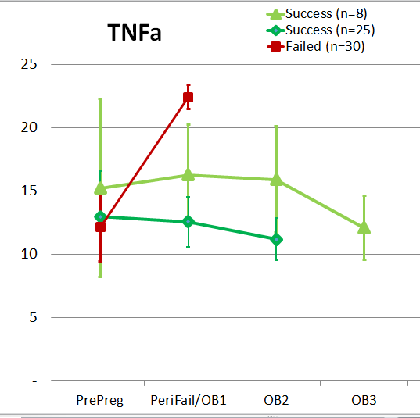
Our Data

Slide 35
Is Intralipid an Inexpensive Alternative to Intravenous Immunoglobulin (IVIG)?
Intralipid touted to public by many clinicians as inexpensive functional alternative to IVIG for treating recurrent pregnancy loss
Pooled IgG antibodies from the serum of thousands of donors
Demonstrated efficacy in treating immunologic abnormalities not thought to be corrected by Intralipid
Elevated intracellular cytokine ratios
Elevated serum cytokines
Elevated autoantibodies/alloantibodies

Slide 36
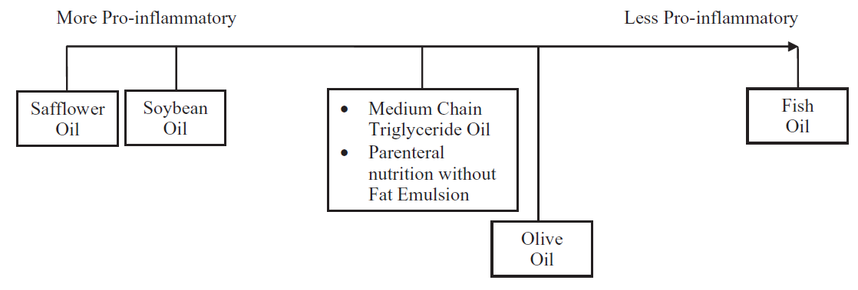
Future of Fat Emulsion Therapy
Using fat emulsions with alternative formulations
Alter the ω-3 to ω-6 ratio of the component PUFAs
Alter the chain length of the component fatty acids
ω-3 benefits not seen with ω-6
Lower serum cytokines
Notes:
Omega 3 formulations may have more benefits in cytokine production inhibition. Linoliec acid shown to stimulate NFkB receptors and omega 3 inhibit having oppostive effects on cytokine production
Due to safety concerns in Ill patients attempts are being made to neutralize some pareneral emulsions.

Slide 37
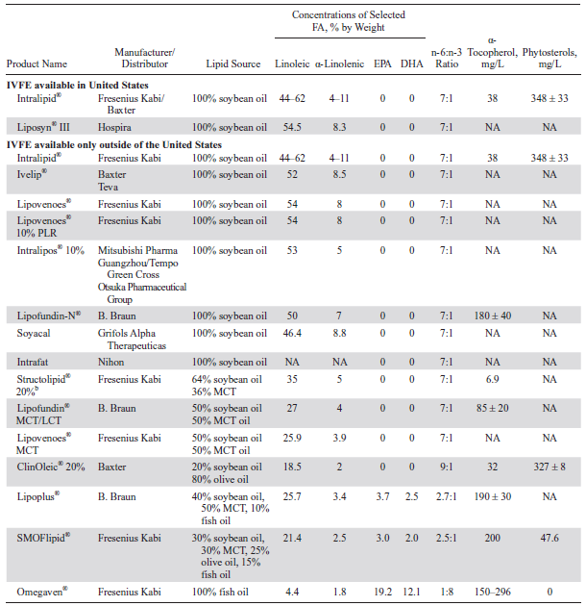
Notes:
2.5/1 ratio is nuetral longer transplant survival at doses much higher or lower .

Slide 38
Future Directions for Basic and Applied Research on Intralipid
Controlled trials of the effects of Intralipid infusion on miscarriage rates in women with RPL
Comparative studies on immunological properties of alternative fat emulsion formulations
Determine EFFECTIVE concentrations of Intralipid necessary to treat multiple immunological etiologies in RPL patients
Clarify relationship between uNK and pNK activity and the effect of IL on uNK cell activity
Identify additional immunological biomarkers (other than NKa) to determine need for alternative or additional therapies
Study the therapeutic role of Intralipid on angiogenesis in pregnancy
Study the effect of Intralipid in different autoimmune syndromes and genetic states (Grimble 2002, showed polymorphisms effect FA action)
Does or heparin or LMWH interfere with the immunosuppressive function of Intralipid?
Is there a place for oral administration (IV Intralipid developed for those that could not tolerate oral route)? There is abundant literature on this.
Study the effect of estrogen on lipid metabolism (many of the studies did not look at gender)
Notes:
Bullet 3, learn the effect of different concentrations on T cell , cytokine , IC ratios , antibody production (all of which have been shown to be affected at different concentrations).

